Slide 1
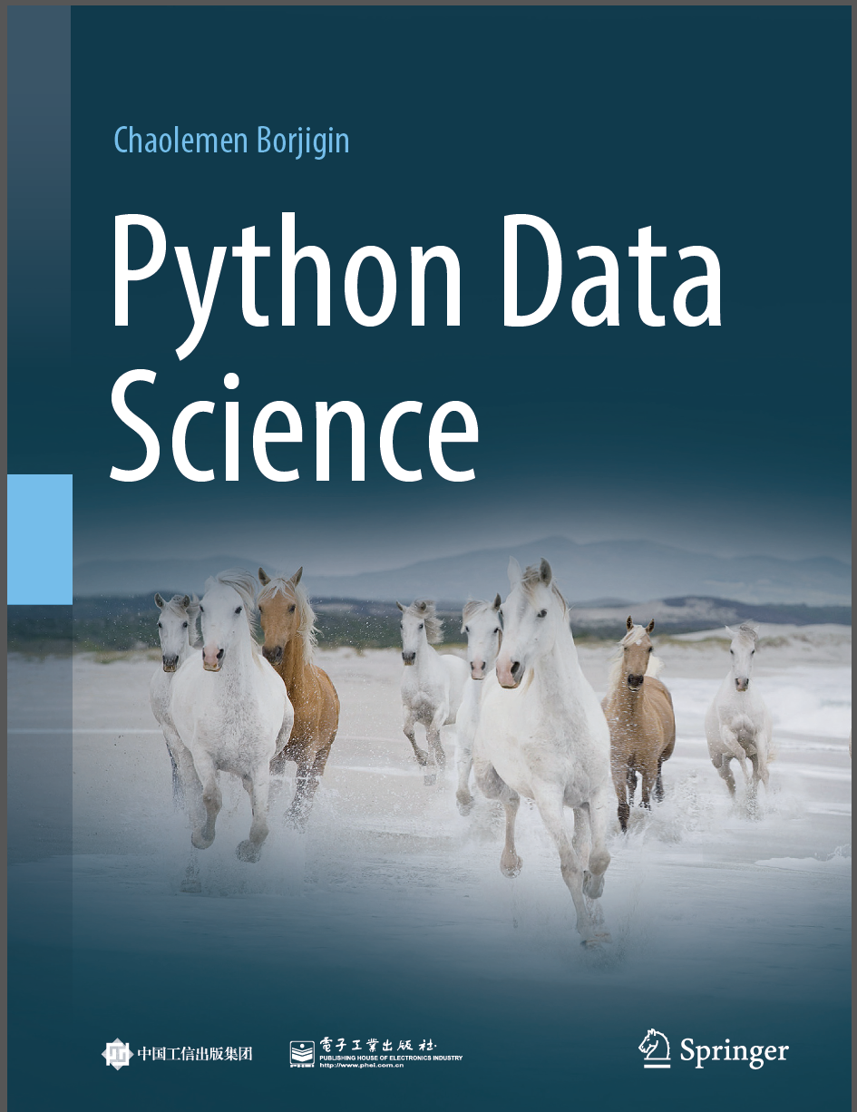
Python Programming —— From Data Analysis to Data Science
Chaolemen Borjigin
Renmin University of China
chaolemen@ruc.edu.cn

Slide 2
4.6 Data visualization
Chaolemen Borjigin
Renmin University of China
chaolemen@ruc.edu.cn

Slide 3
Summary of this chapter
▼Chapter 4 Data processing
► 4.6 Data visualization
4.6.1 Matplotlib visualization
4.6.2 Adjusting plot attributes
4.6.3 Changing the type of a plot
4.6.4 Changing the value range of the axes of a plot
4.6.5 Adjusting the margins of a plot
4.6.6 Creating multiple plots on the same coordinates

Slide 4
Summary of this chapter
▼Chapter 4 Data processing
► 4.6 Data visualization
4.6.7 Adding an Axes to the current fgure or retrieving an existing Axes
4.6.8 Saving plots to image fles
4.6.9 Creating more complicate plots
4.6.10 Data visualization with Pandas
4.6.11 Data visualization with Seaborn
4.6.12 Data visualization cases projects

Slide 5
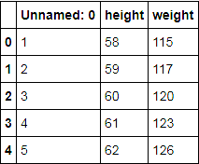
4.6.1 Matplotlib visualization
▼Chapter 4 Data processing
► 4.6 Data visualization
In[2]:
import matplotlib.pyplot as plt
%matplotlib inline
import pandas as pd
women = pd.read_csv('women.csv')
women.head()
In[3]:
Out[3]:

Slide 6
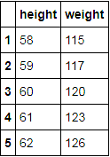
4.6.1 Matplotlib visualization
▼Chapter 4 Data processing
► 4.6 Data visualization
In[4]:
women = pd.read_csv('women.csv',index_col =0)
women.head()
Out[4]:

Slide 7
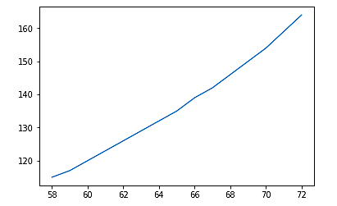
4.6.1 Matplotlib visualization
▼Chapter 4 Data processing
► 4.6 Data visualization
In[5]:
plt.plot(women["height"], women["weight"])
plt.show()

Slide 8
4.6.1 Matplotlib visualization
▼Chapter 4 Data processing
► 4.6 Data visualization
import numpy as np
t=np.arange(0.,4.,0.1)
t
In[6]:
array([0. , 0.1, 0.2, 0.3, 0.4, 0.5, 0.6, 0.7, 0.8, 0.9, 1. , 1.1, 1.2,
1.3, 1.4, 1.5, 1.6, 1.7, 1.8, 1.9, 2. , 2.1, 2.2, 2.3, 2.4, 2.5,
2.6, 2.7, 2.8, 2.9, 3. , 3.1, 3.2, 3.3, 3.4, 3.5, 3.6, 3.7, 3.8,
3.9])
Out[6]:

Slide 9
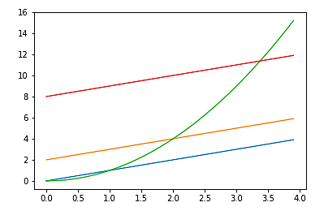
4.6.1 Matplotlib visualization
▼Chapter 4 Data processing
► 4.6 Data visualization
plt.plot(t,t,t,t+2,t,t**2,t,t+8)
plt.show()
In[7]:

Slide 10
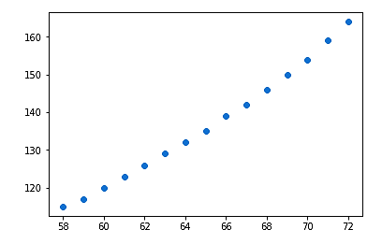
4.6.2 Adjusting plot attributes
▼Chapter 4 Data processing
► 4.6 Data visualization
plt.plot(women["height"], women["weight"],"o")
plt.show()
In[8]:

Slide 11
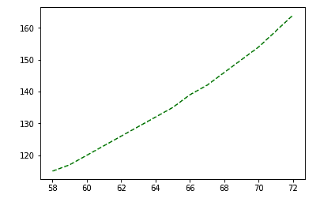
4.6.2 Adjusting plot attributes
▼Chapter 4 Data processing
► 4.6 Data visualization
plt.plot(women["height"], women["weight"],"g--")
plt.show()
In[9]:

Slide 12
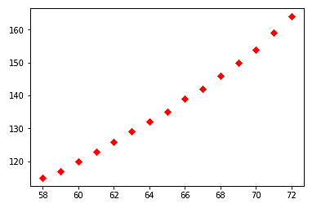
4.6.2 Adjusting plot attributes
▼Chapter 4 Data processing
► 4.6 Data visualization
plt.plot(women["height"], women["weight"],"rD")
plt.show()
In[10]:

Slide 13
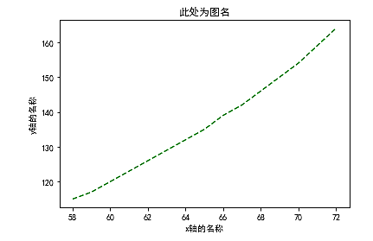
4.6.2 Adjusting plot attributes
▼Chapter 4 Data processing
► 4.6 Data visualization
plt.rcParams['font.family']="SimHei"
plt.plot(women["height"], women["weight"],"g--")
plt.title("plotting the dataset women")
plt.xlabel("height")
plt.ylabel("weight")
plt.show()
In[11]:

Slide 14
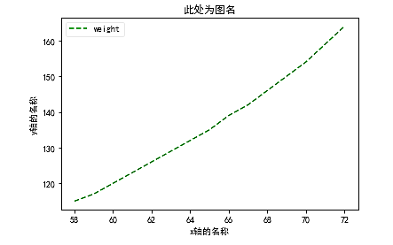
4.6.2 Adjusting plot attributes
▼Chapter 4 Data processing
► 4.6 Data visualization
plt.rcParams['font.family']="SimHei"
plt.plot(women["height"], women["weight"],"g--")
plt.title(“plotting the dataset women”)
plt.xlabel("height")
plt.ylabel("weight")
plt.legend(loc="upper left“, labels=[“weight”])
plt.show()
In[13]:

Slide 15
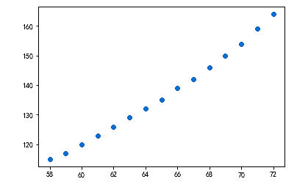
4.6.3 Changing the type of a plot
▼Chapter 4 Data processing
► 4.6 Data visualization
plt.scatter(women["height"], women["weight"])
plt.show()
In[14]:

Slide 16
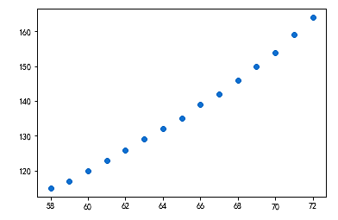
4.6.3 Changing the type of a plot
▼Chapter 4 Data processing
► 4.6 Data visualization
%matplotlib inline
plt.scatter(women.height, women.weight)
In[15]:
Out[15]:
<matplotlib.collections.PathCollection at 0x21b93e51400>

Slide 17
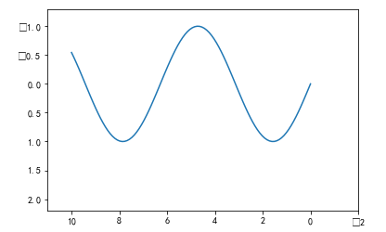
4.6.4 Changing the value range of the axes of a plot
▼Chapter 4 Data processing
► 4.6 Data visualization
import matplotlib.pyplot as plt
import numpy as np
%matplotlib inline
x=np.linspace(0,10,100)
plt.plot(x,np.sin(x))
plt.xlim(11,-2)
plt.ylim(2.2,-1.3)
In[16]:
(2.2, -1.3)
Out[16]:

Slide 18
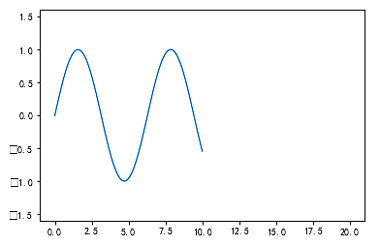
4.6.4 Changing the value range of the axes of a plot
▼Chapter 4 Data processing
► 4.6 Data visualization
plt.plot(x,np.sin(x))
plt.axis([-1,21,-1.6,1.6])
In[17]:
[-1, 21, -1.6, 1.6]
Out[17]:

Slide 19
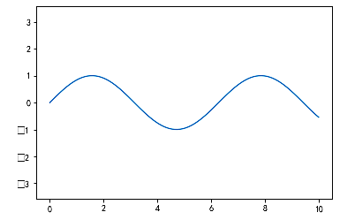
4.6.4 Changing the value range of the axes of a plot
▼Chapter 4 Data processing
►4.6 Data visualization
plt.plot(x,np.sin(x))
plt.axis([-1,21,-1.6,1.6])
plt.axis("equal")
In[18]:
Out[18]:
(-0.5, 10.5, -1.0993384025373631, 1.0996461858110391)

Slide 20
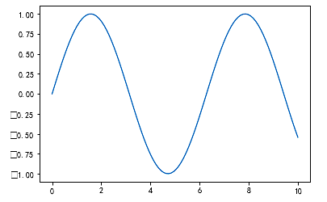
4.6.5 Adjusting the margins of a plot
▼Chapter 4 Data processing
► 4.6 Data visualization
plt.plot(x,np.sin(x))
plt.axis([-1,21,-1.6,1.6])
plt.axis("tight")
In[19]:
(-0.5, 10.5, -1.0993384025373631, 1.0996461858110391)
Out[19]:

Slide 21
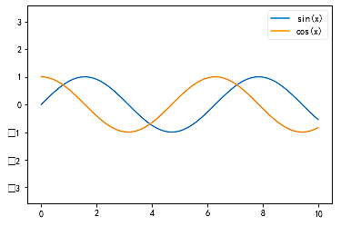
4.6.6 Creating multiple plots on the same coordinates
▼Chapter 4 Data processing
► 4.6 Data visualization
plt.plot(x,np.sin(x),label="sin(x)")
plt.plot(x,np.cos(x),label="cos(x)")
plt.axis("equal")
plt.legend()
In[20]:
<matplotlib.legend.Legend at 0x21b92a6dbe0>
Out[20]:

Slide 22
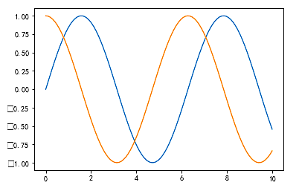
4.6.6 Creating multiple plots on the same coordinates
▼Chapter 4 Data processing
► 4.6 Data visualization
plt.plot(x,np.sin(x),label="sin(x)")
plt.plot(x,np.cos(x),label="cos(x)")
In[21]:
[<matplotlib.lines.Line2D at 0x21b93d6f630>]
Out[21]:

Slide 23
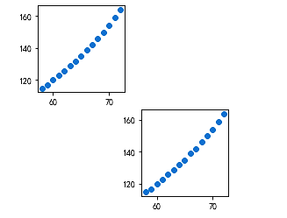
4.6.7 Adding an Axes to the current fgure or retrieving an existing Axes
▼Chapter 4 Data processing
► 4.6 Data visualization
plt.subplot(2,3,5)
plt.scatter(women["height"], women["weight"])
plt.subplot(2,3,1)
plt.scatter(women["height"], women["weight"])
plt.show()
In[22]:

Slide 24
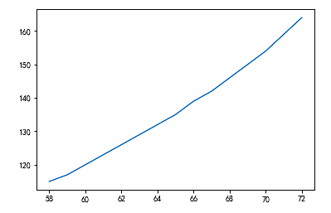
4.6.8 Saving plots to image fles
▼Chapter 4 Data processing
► 4.6 Data visualization
women = pd.read_csv('women.csv')
plt.plot(women.height, women.weight)
plt.savefig("sagefig.png")
In[23]:

Slide 25
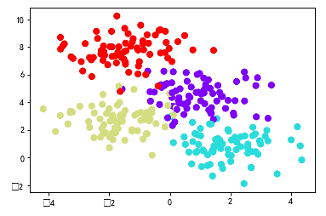
4.6.9 Creating more complicate plots
▼Chapter 4 Data processing
► 4.6 Data visualization
from sklearn.datasets.samples_generator import make_blobs
X,y=make_blobs(n_samples=300,centers=4,random_state=0, cluster_std=1.0)
plt.scatter(X[:,0],X[:,1],c=y,s=50,cmap="rainbow")
In[24]:
<matplotlib.collections.PathCollection at 0x21b9484ee80>
Out[24]:

Slide 26
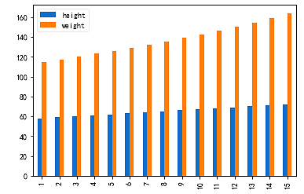
4.6.10 Data visualization with Pandas
▼Chapter 4 Data processing
► 4.6 Data visualization
import pandas as pd
women = pd.read_csv('women.csv',index_col =0)
women.plot(kind="bar")
plt.show()
In[25]:
Out[25]:

Slide 27
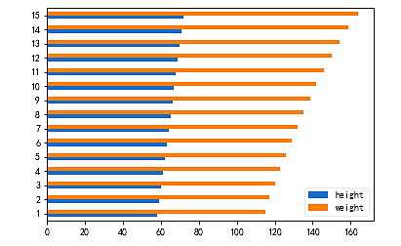
4.6.10 Data visualization with Pandas
▼Chapter 4 Data processing
► 4.6 Data visualization
women.plot(kind="barh")
plt.show()
In[26]:
Out[26]:

Slide 28
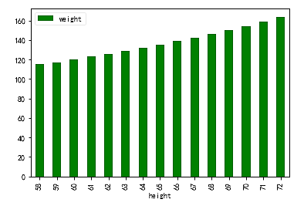
4.6.10 Data visualization with Pandas
▼Chapter 4 Data processing
► 4.6 Data visualization
women.plot(kind="bar",x="height",y="weight",color="g")
plt.show()
In[27]:
Out[27]:

Slide 29
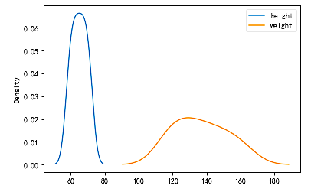
4.6.10 Data visualization with Pandas
▼Chapter 4 Data processing
► 4.6 Data visualization
women.plot(kind="kde")
plt.show()
In[28]:
Out[28]:

Slide 30
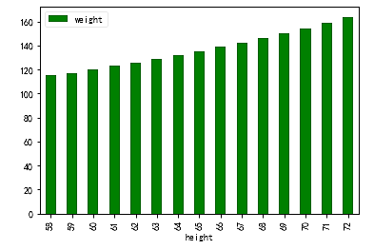
4.6.10 Data visualization with Pandas
▼Chapter 4 Data processing
► 4.6 Data visualization
women.plot(kind="bar",x="height",y="weight",color="g")
plt.legend(loc="best")
plt.show()
In[29]:
Out[29]:

Slide 31
4.6.11 Data visualization with Seaborn
▼Chapter 4 Data processing
► 4.6 Data visualization
import matplotlib.pyplot as plt
plt.style.use("classic")
%matplotlib inline
import numpy as np
import pandas as pd
In[30]:
rng= np.random.RandomState(0)
x=np.linspace(0,10,500)
y=np.cumsum(rng.randn(500,6),0)
In[31]:

Slide 32
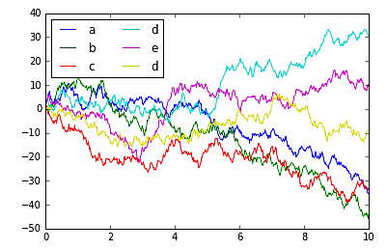
4.6.11 Data visualization with Seaborn
▼Chapter 4 Data processing
► 4.6 Data visualization
plt.plot(x,y)
plt.legend("abcded",ncol=2,loc="upper left")
In[32]:
Out[32]:
<matplotlib.legend.Legend at 0x21b94a676a0>

Slide 33
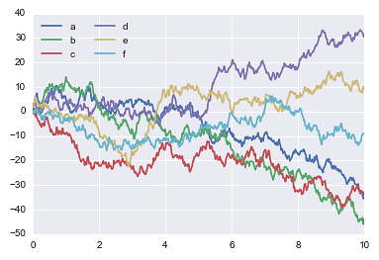
4.6.11 Data visualization with Seaborn
▼Chapter 4 Data processing
► 4.6 Data visualization
import seaborn as sns
sns.set()
plt.plot(x,y)
plt.legend("abcdef",ncol=2,loc="upper left")
In[33]:
Out[33]:
<matplotlib.legend.Legend at 0x21b94be14a8>

Slide 34
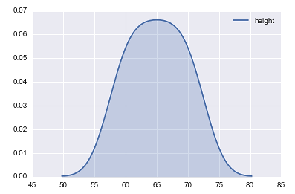
4.6.11 Data visualization with Seaborn
▼Chapter 4 Data processing
► 4.6 Data visualization
In[34]:
sns.kdeplot(women.height, shade=True)
<matplotlib.axes._subplots.AxesSubplot at 0x21b94b3fc18>
Out[34]:

Slide 35
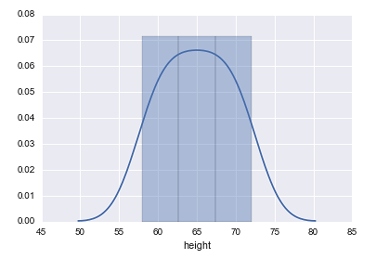
4.6.11 Data visualization with Seaborn
▼Chapter 4 Data processing
► 4.6 Data visualization
In[35]:
sns.distplot(women.height)
<matplotlib.axes._subplots.AxesSubplot at 0x21b94a14710>
Out[35]:

Slide 36
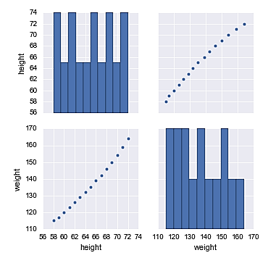
4.6.11 Data visualization with Seaborn
▼Chapter 4 Data processing
► 4.6 Data visualization
In[36]:
sns.pairplot(women)
<seaborn.axisgrid.PairGrid at 0x21b948b4a20>
Out[36]:

Slide 37
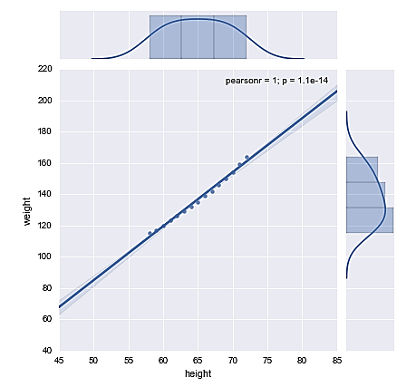
4.6.11 Data visualization with Seaborn
▼Chapter 4 Data processing
► 4.6 Data visualization
In[37]:
sns.jointplot(women.height,women.weight,kind="reg")
<seaborn.axisgrid.JointGrid at 0x21b94f5d7f0>
Out[37]:

Slide 38
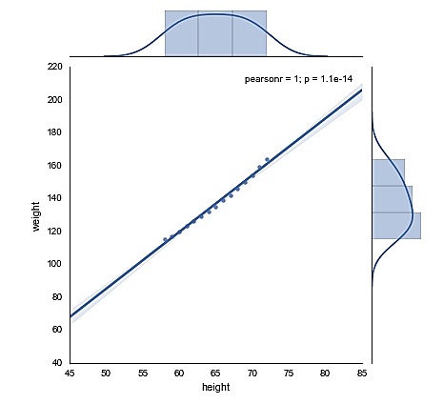
4.6.11 Data visualization with Seaborn
▼Chapter 4 Data processing
► 4.6 Data visualization
with sns.axes_style("white"):
sns.jointplot(women.height,women.weight,kind="reg")
In[38]:
Out[38]:

Slide 39
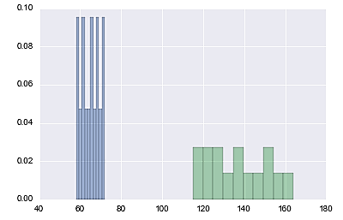
4.6.11 Data visualization with Seaborn
▼Chapter 4 Data processing
► 4.6 Data visualization
for x in ["height","weight"]:
plt.hist(women[x],normed=True,alpha=0.5)
In[39]:
Out[39]:

Slide 40
4.6.12 Data visualization cases projects
▼Chapter 4 Data processing
► 4.6 Data visualization
import os
os.getcwd()
In[40]:
Out[40]:
'C:\\Users\\soloman\\clm'
import pandas as pd
salaries = pd.read_csv('salaries.csv', index_col=0)
In[41]:

Slide 41
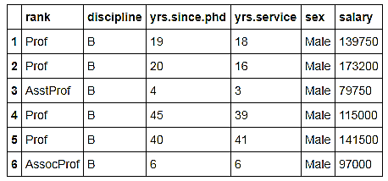
4.6.12 Data visualization cases projects
▼Chapter 4 Data processing
► 4.6 Data visualization
salaries.head(6)
In[42]:
Out[42]:

Slide 42
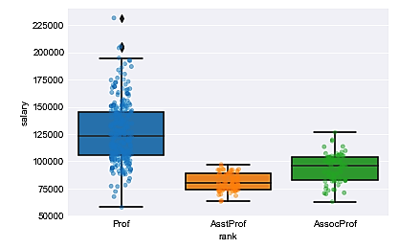
4.6.12 Data visualization cases projects
▼Chapter 4 Data processing
► 4.6 Data visualization
In[43]:
import seaborn as sns
In[44]:
sns.set_style('darkgrid')
sns.stripplot(data=salaries, x='rank', y='salary', jitter=True, alpha=0.5)
sns.boxplot(data=salaries, x='rank', y='salary')
<matplotlib.axes._subplots.AxesSubplot at 0x288151c66d8>
Out[44]:

Slide 43


